Slide 1



CDC Causes of Death for 2017
View in Power BI
Last data refresh:
8/2/2021 8:45:05 PM UTC
Downloaded at:
8/2/2021 8:46:17 PM UTC

Slide 2
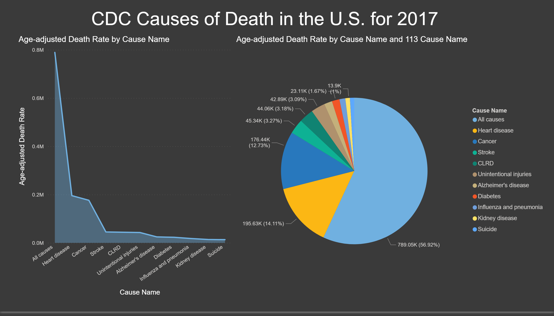
Page 1
Notes:
textbox
No alt text provided.
pieChart
No alt text provided.
areaChart
No alt text provided.

